Slide 1


Lecture 6
Produced by Dr. Worldwide
Welcome to the 305
~
~

Slide 2


Ex: Quick-Screen Clothing
Quick-Screen is a clothing manufacturing company specializing in the production of commemorative shirts immediately following major sporting events and they have a contract to produce shirts for winning team of a college football bowl game on New Year’s Day between State and Tech
They will produce two different sweatshirts and two different t-shirts with one of each having writing on front (F) only and the other having writing on both front (F) and back (B)
All items will be produced by the box where each box contains a dozen items
Q: How much of each of the items should be produced to maximize profit?

Slide 3
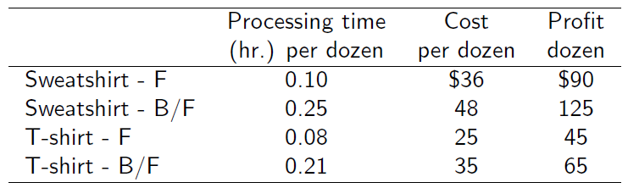
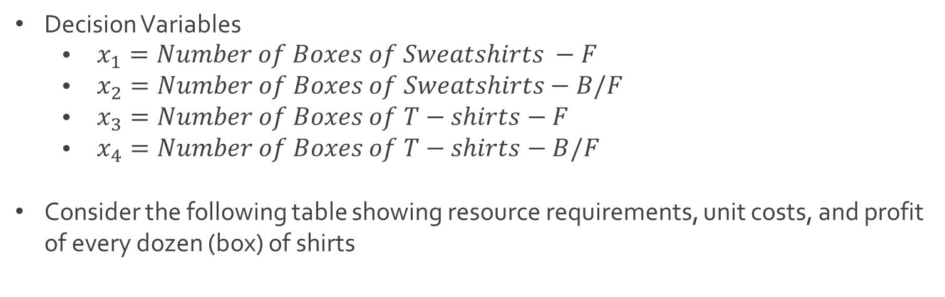
Ex: Quick-Screen Clothing
Decision Variables
$\begin{aligned} x_{1}=Number of Boxes of Sweatshirts −F\end{aligned}$
$\begin{aligned} x_{2}=Number of Boxes of Sweatshirts−\#B/F\end{aligned}$
$\begin{aligned} x_{3}=Number of Boxes of T−shirts−F\end{aligned}$
$\begin{aligned} x_{4}=Number of Boxes of T−shirts−B/F\end{aligned}$
Consider the following table showing resource requirements, unit costs, and profit of every dozen (box) of shirts

Slide 4
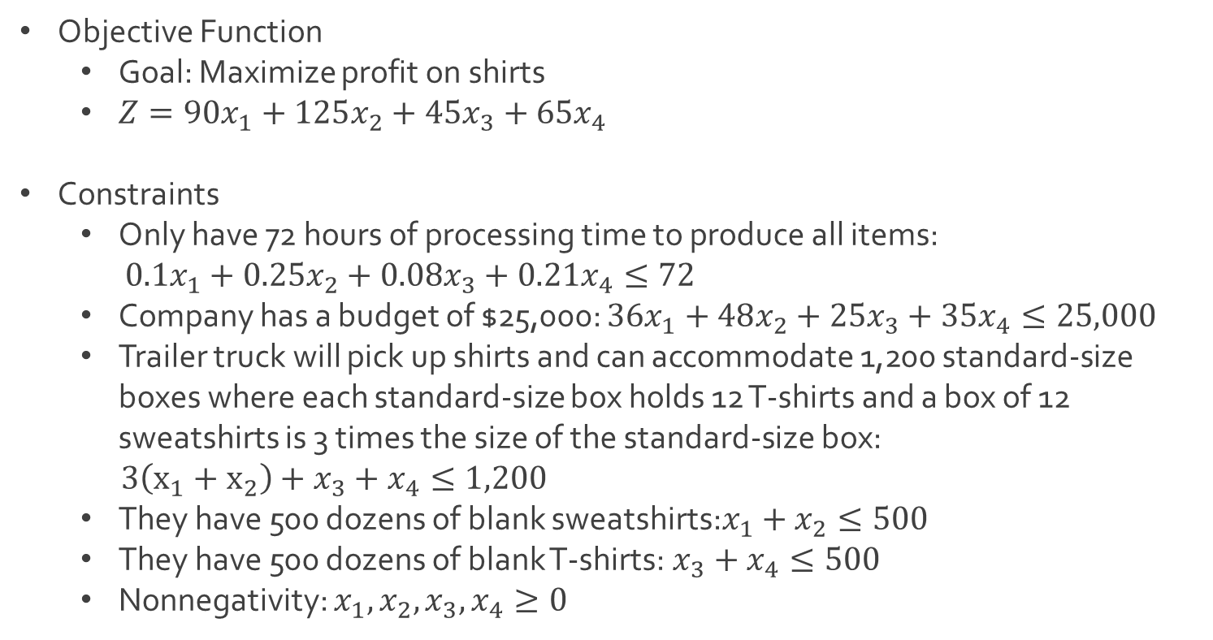
Ex: Quick-Screen Clothing
Objective Function
Goal: Maximize profit on shirts
$Z=90x_{1}+125x_{2}+45x_{3}+65x_{4}$
Constraints
Only have 72 hours of processing time to produce all items:
$0.1x_{1}+0.25x_{2}+0.08x_{3}+0.21x_{4}≤72$
Company has a budget of $25,000: $36x_{1}+48x_{2}+25x_{3}+35x_{4}≤25,000$
Trailer truck will pick up shirts and can accommodate 1,200 standard-size boxes where each standard-size box holds 12 T-shirts and a box of 12 sweatshirts is 3 times the size of the standard-size box:
$3\left(x_{1}+x_{2}\right)+x_{3}+x_{4}≤1,200$
They have 500 dozens of blank sweatshirts:$x_{1}+x_{2}≤500$
They have 500 dozens of blank T-shirts:$x_{3}+x_{4}≤500$
Nonnegativity: $x_{1},x_{2},x_{3},x_{4}≥0$

Slide 5
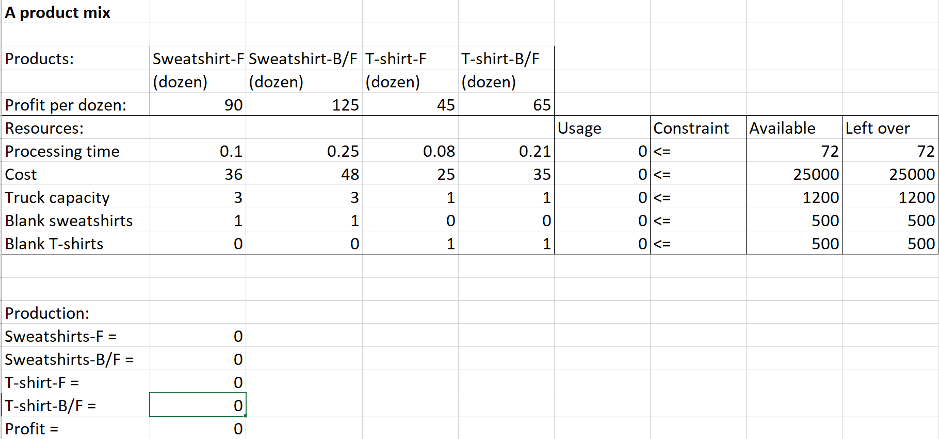
Ex: Quick-Screen Clothing
Download ProductMix.xlsx from website link called Sheet 1
Before Excel solver

Slide 6
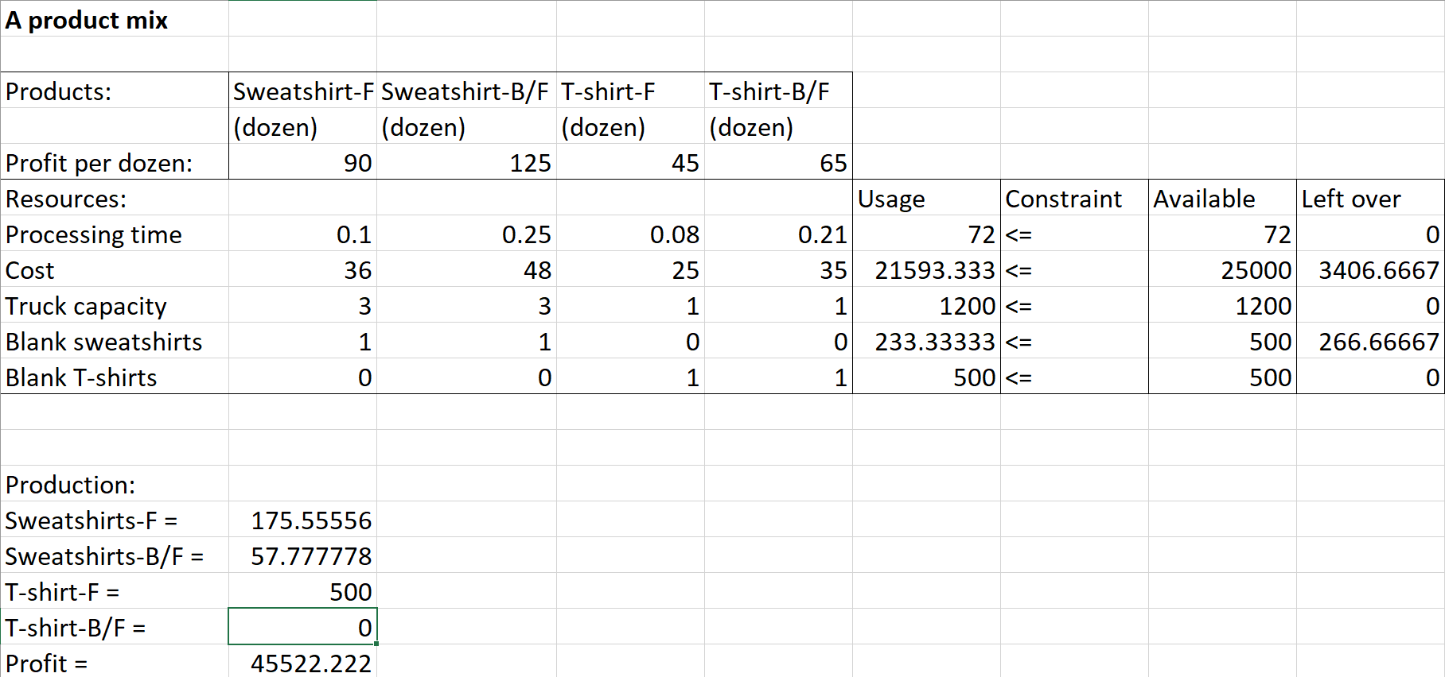
Ex: Quick-Screen Clothing
After Excel solver

Slide 7
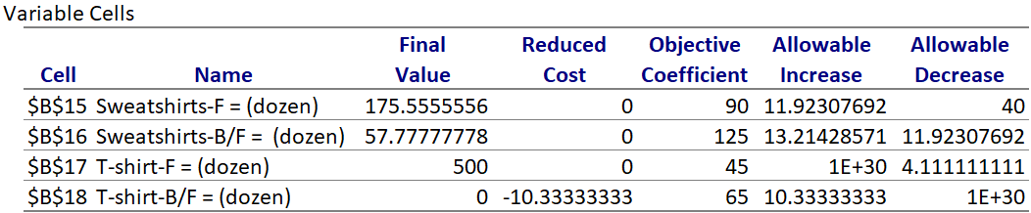
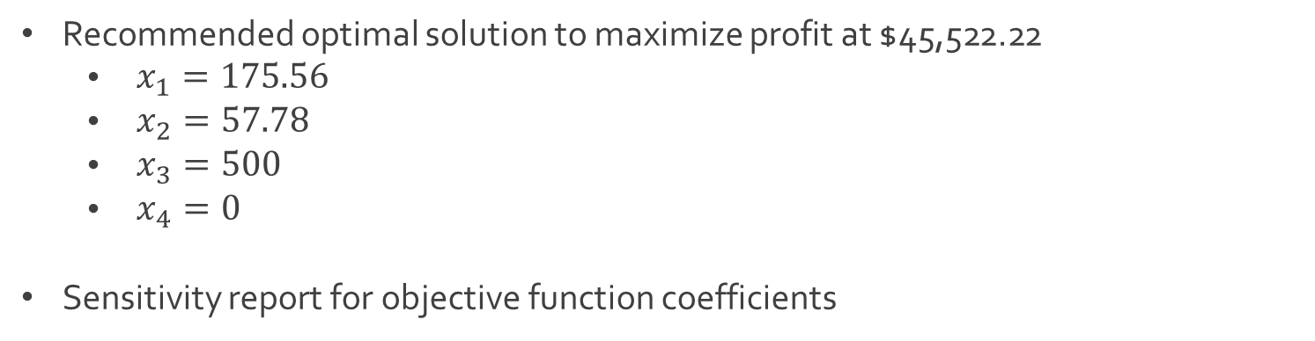
Ex: Quick-Screen Clothing
Recommended optimal solution to maximize profit at $45,522.22
$\begin{aligned} x_{1}=175.56\end{aligned}$
$\begin{aligned} x_{2}=57.78\end{aligned}$
$\begin{aligned} x_{3}=500\end{aligned}$
$\begin{aligned} x_{4}=0\end{aligned}$
Sensitivity report for objective function coefficients

Slide 8
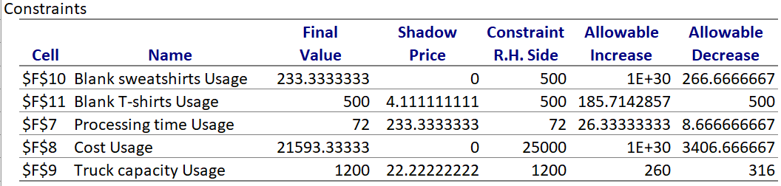
Ex: Quick-Screen Clothing
Sensitivity report for constraint quantities

Slide 9
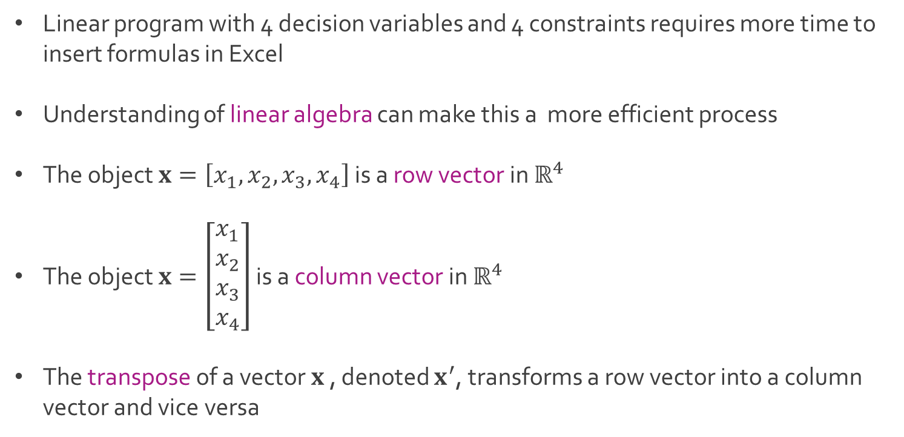
Vectors and Matrices
Linear program with 4 decision variables and 4 constraints requires more time to insert formulas in Excel
Understanding of linear algebra can make this a more efficient process
The object $x=\left[x_{1}, x_{2},x_{3},x_{4}\right]$ is a row vector in $ℝ^{4}$
The object $x=\left[\begin{matrix}x_{1} \\ x_{2} \\ x_{3} \\ x_{4}\end{matrix}\right]$ is a column vector in $ℝ^{4}$
The transpose of a vector $x$ , denoted $x^{′}$, transforms a row vector into a column vector and vice versa

Slide 10
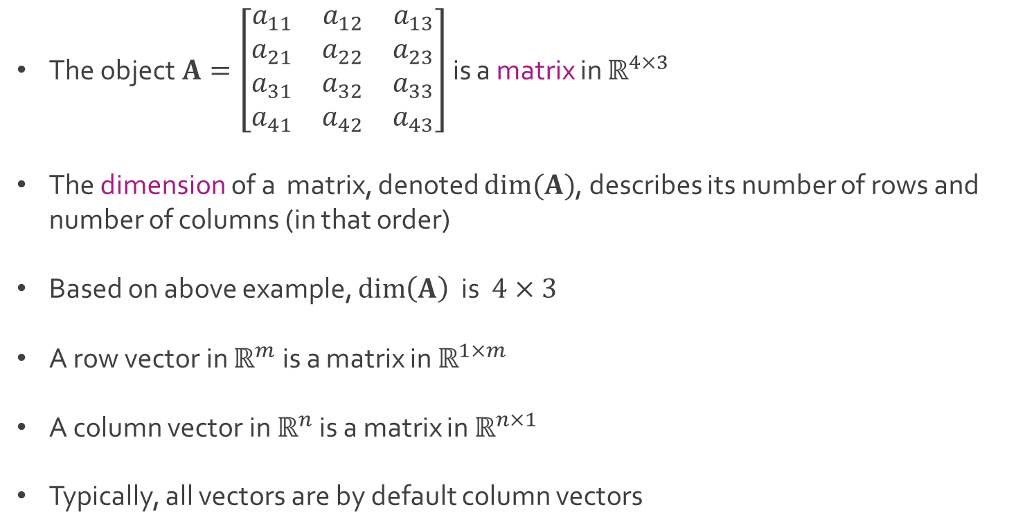
Vectors and Matrices
The object $A=\left[\begin{matrix}a_{11} & a_{12} & a_{13} \\ a_{21} & a_{22} & a_{23} \\ a_{31} & a_{32} & a_{33} \\ a_{41} & a_{42} & a_{43}\end{matrix}\right]$ is a matrix in $ℝ^{4×3}$
The dimension of a matrix, denoted $dim⁡(A)$, describes its number of rows and number of columns (in that order)
Based on above example, $\dim\left(A\right)$ is $4×3$
A row vector in $ℝ^{m}$ is a matrix in $ℝ^{1×m}$
A column vector in $ℝ^{n}$ is a matrix in $ℝ^{n×1}$
Typically, all vectors are by default column vectors

Slide 11
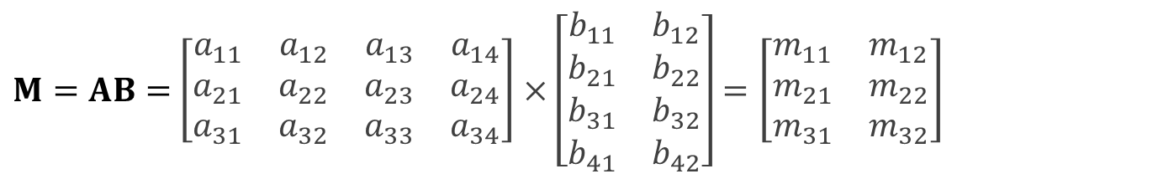

Vectors and Matrices
For matrices $A∈ℝ^{m×n}$ and $B∈ℝ^{n×p}$, we can define their product $M=AB$, which will be a matrix in $ℝ^{m×p}$
For $A∈ℝ^{3×4}$ and $B∈ℝ^{4×2}$, matrix $M=AB$ can be expressed as
where
In order to compute, $M=AB$, the number of columns in $A$ must equal the number of rows in $B$
In above example, the matrix $M=BA$ does not exist
$M=AB=$ $\left[\begin{matrix}a_{11} & a_{12} & a_{13} & a_{14} \\ a_{21} & a_{22} & a_{23} & a_{24} \\ a_{31} & a_{32} & a_{33} & a_{34}\end{matrix}\right]×\left[\begin{matrix}b_{11} & b_{12} \\ b_{21} & b_{22} \\ b_{31} & b_{32} \\ b_{41} & b_{42}\end{matrix}\right]=\left[\begin{matrix}m_{11} & m_{12} \\ m_{21} & m_{22} \\ m_{31} & m_{32}\end{matrix}\right]$
$$m_{ij}=a_{i1}b_{1j}+a_{i2}b_{2j}+a_{i3}b_{j3}+a_{i4}b_{4j} for i=1,2,3 and j=1,2$$

Slide 12
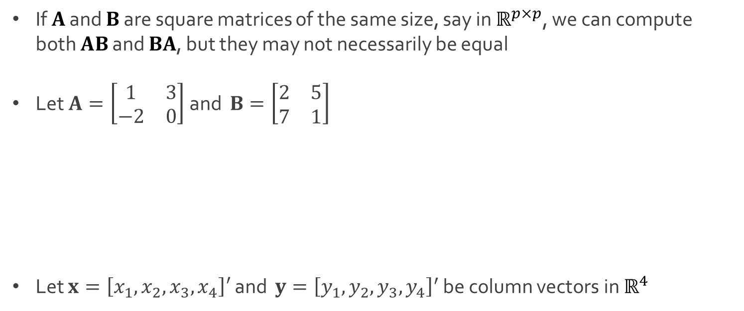
Vectors and Matrices
If $A$ and $B$ are square matrices of the same size, say in $ℝ^{p×p}$, we can compute both $AB$ and $BA$, but they may not necessarily be equal
Let $A=\left[\begin{matrix}1 & 3 \\ −2 & 0\end{matrix}\right]$ and $B=\left[\begin{matrix}2 & 5 \\ 7 & 1\end{matrix}\right]$
Let $x=\left[x_{1}, x_{2},x_{3},x_{4}\right]′$ and $y={\left[y_{1}, y_{2},y_{3},y_{4}\right]}^{′}$ be column vectors in $ℝ^{4}$
$$AB=\left[\begin{matrix}1×2+3×7 & 1×5+3×1 \\ −2×2+0×7 & −2×5+0×1\end{matrix}\right]=\left[\begin{matrix}23 & 8 \\ −4 & −10\end{matrix}\right]$$
$$BA=\left[\begin{matrix}2×1+5×−2 & 2×3+5×0 \\ 7×1+1×−2 & 7×3+1×0\end{matrix}\right]=\left[\begin{matrix}−8 & 6 \\ 5 & 21\end{matrix}\right]$$
$$x^{′}y=x_{1}y_{1}+x_{2}y_{2}+x_{3}y_{3}+x_{4}y_{4}=y^{′}x$$

Slide 13
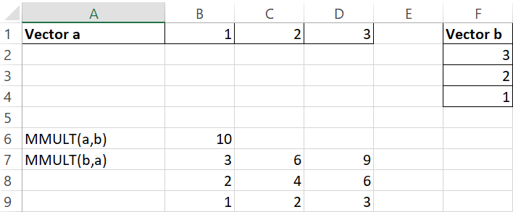
Excel: Matrix Multiplication
MMULT Function in Excel
The MMULT Function in Excel is used to multiply arrays (matrices) that have compatible dimensions and returns an array (matrix)
Syntax: MMULT(array1,array2)
Example: Vector Multiplication

Slide 14
Excel: Matrix Multiplication
MMULT Function in Excel
The MMULT function in Excel is used to multiply arrays (matrices) that have compatible dimensions and returns an array (matrix)
Syntax: MMULT(array1,array2)
Example: Vector Multiplication
=MMULT(B1:D1,F2:F4)

Slide 15
Excel: Matrix Multiplication
MMULT Function in Excel
The MMULT Function in Excel is used to multiply arrays (matrices) that have compatible dimensions and returns an array (matrix)
Syntax: MMULT(array1,array2)
Example: Vector Multiplication
=MMULT(F2:F4,
B1:D1)

Slide 16
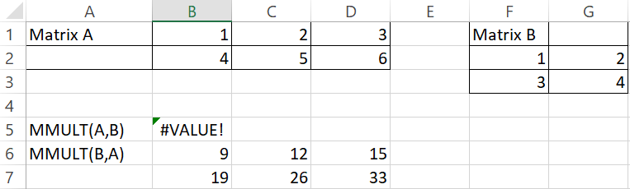
Excel: Matrix Multiplication
MMULT Function in Excel
Example: Matrix Multiplication

Slide 17
Excel: Matrix Multiplication
MMULT Function in Excel
Example: Matrix Multiplication
=MMULT(B1:D2,F2:G3)

Slide 18
Excel: Matrix Multiplication
MMULT Function in Excel
Example: Matrix Multiplication
=MMULT(F2:G3,B1:D2)

Slide 19
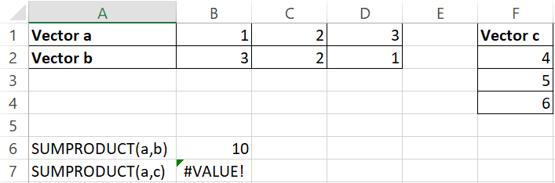
Excel: Matrix Multiplication
SUMPRODUCT Function in Excel
The SUMPRODUCT function in Excel is used to multiply arrays (matrices) element-wise and then returns the sum of their products
In mathematics, this is often referred to as a dot-product or vector-product when the arrays are vectors
Syntax: SUMPRODUCT(array1,array2)
Ex: Usage on Vectors

Slide 20
Excel: Matrix Multiplication
SUMPRODUCT Function in Excel
The SUMPRODUCT function in Excel is used to multiply arrays (matrices) element-wise and then returns the sum of their products
In mathematics, this is often referred to as a dot-product or vector-product when the arrays are vectors
Syntax: SUMPRODUCT(array1,array2)
Ex: Usage on Vectors
=SUMPRODUCT(B1:D1,B2:D2)

Slide 21
Excel: Matrix Multiplication
SUMPRODUCT Function in Excel
The SUMPRODUCT function in Excel is used to multiply arrays (matrices) element-wise and then returns the sum of their products
In mathematics, this is often referred to as a dot-product when the arrays are vectors
Syntax: SUMPRODUCT(array1,array2)
Ex: Usage on Vectors
=SUMPRODUCT(B1:D1,F2:F4)

Slide 22
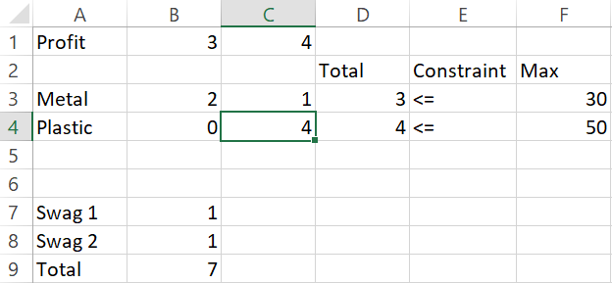
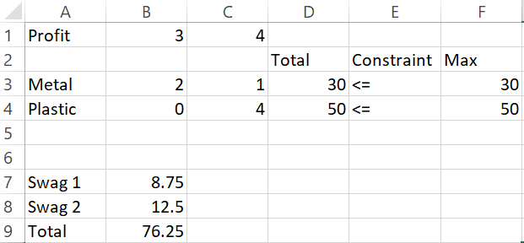
Excel: Application of Matrices
Both MMULT and SUMPRODUCT can be used in Excel to make the creation of formulas and constraints of linear programs considerably easier
Made up example for practice
Solver

Slide 23
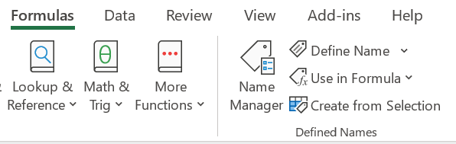
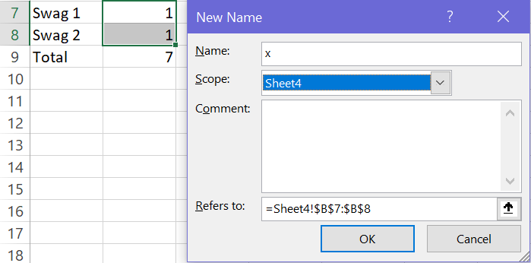
Excel: Application of Matrices
Creating EXCEL variable for easy referencing

Slide 24
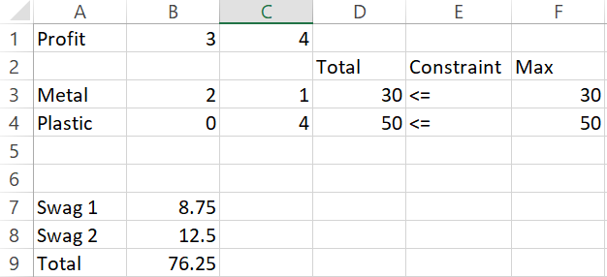
Excel: Application of Matrices
Usage of created variable in establishing constraints and objective function
=MMULT(B4:C4,x)
=MMULT(B1:C1,x)

Slide 25
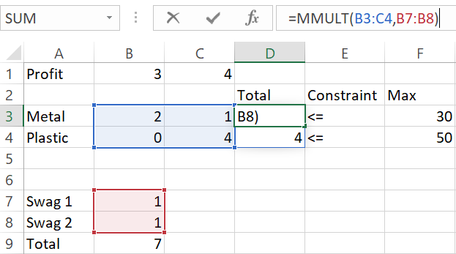
Excel: Application of Matrices
Another option for specification

Slide 26
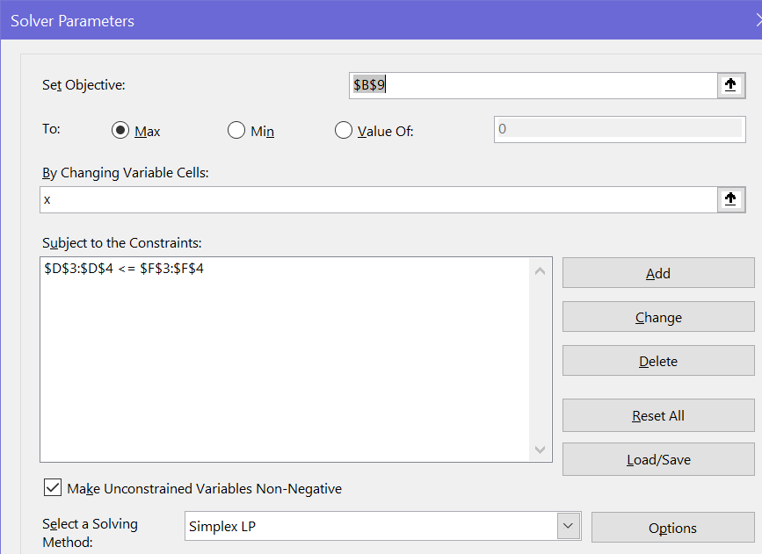
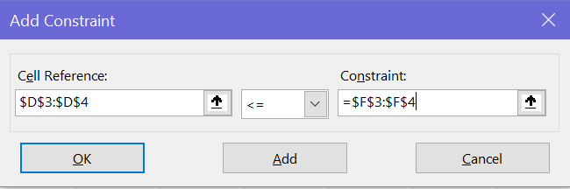
Excel: Application of Matrices
Another option for specification

Slide 27
Excel: Application of Matrices
Try using MMULT and SUMPRODUCT in cell formulas
Try using vectors/matrices in specification of constraints
Download Lecture6WS.xlsx from course website from link Sheet 2 for all examples seen in this lecture

Slide 28




The End
Dale

